Slide 1
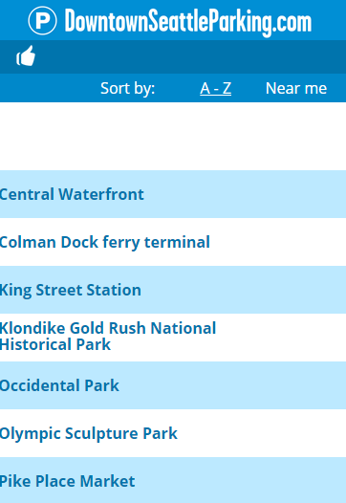
Fix header titles
Fix spacing issues
Adding 4 Popular Destinations:
Washington State Convention Ctr
Westlake Park
Freeway Park
Seattle Public Library

Slide 2
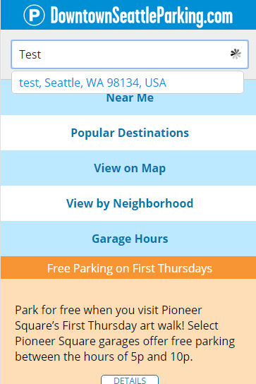
Add “clear field” ‘X’ to search box

Slide 3
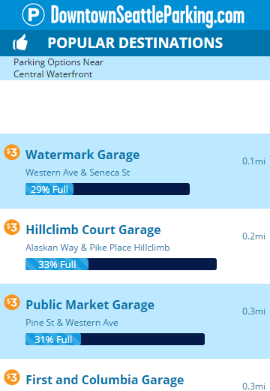
Limit $3/hour preferred results to 2-3 garages

Slide 4
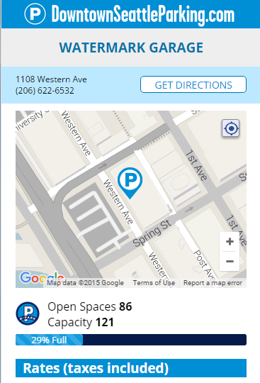
Add back button & home button
Add pindrop when user has searched by specific location
Update icon to match garage type
Add descriptor of garage type/icon

Slide 5
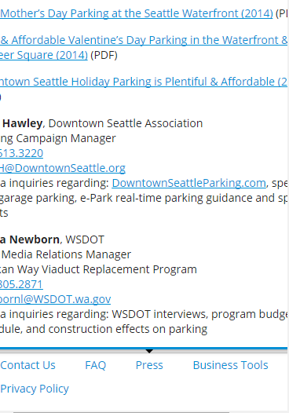
Fix ‘Press’ & ‘Business Tools’ zoom issue

Slide 6
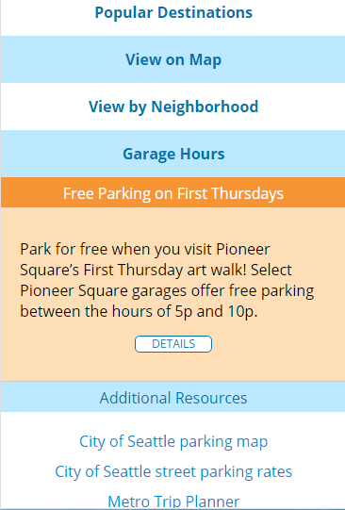
Review layout when we invert promo box & ‘Add’l Resources’

Slide 7
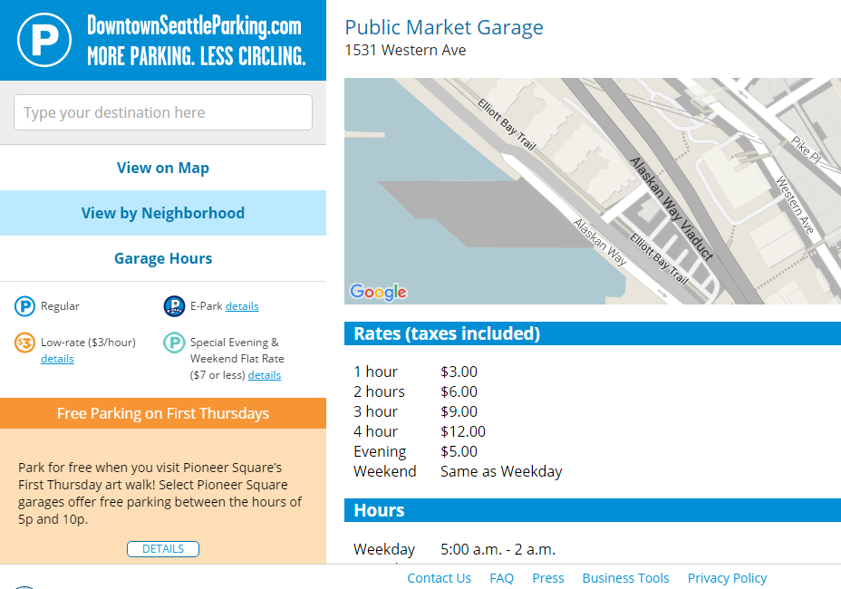
Parking pin not showing up on garage page
Pin of destination to show up when user searches by location

Slide 8
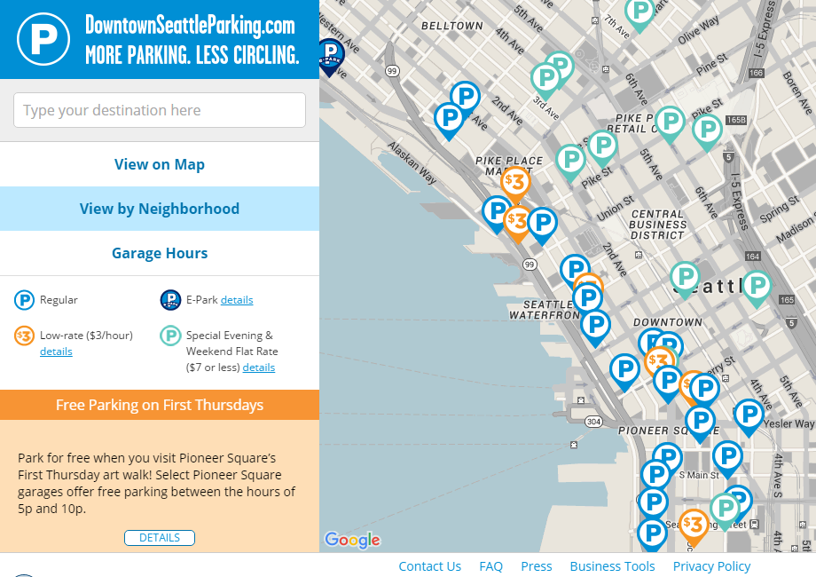
Move $3 pins to front
Lowercase ‘e’ in e-Park
Add 3 garages:
1. Diamond Lot
922 1st Ave S
2. Diamond Lot
1000 1st Ave S
3. Dome Parking
Update functionality of View on Map / View By Neighborhood / Garage Hours
Make ‘View on Map’ and ‘Garage Hours’ blue so ‘View by Neighborhood’ doesn’t look highlighted

Slide 9
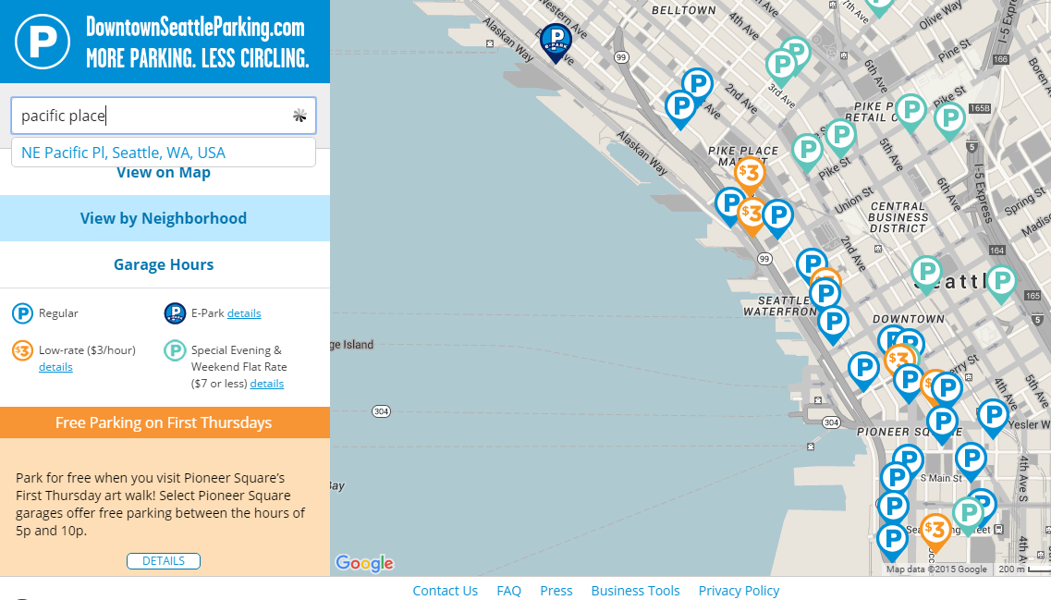
Update Search API to add one more layer of depth in Google

